Slide 1
Presentation On
Online Pet Food and Accessories Selling Website
Project Name: Pet Club
Presented By
Innovative Thinkers
Batch: 15th

Slide 2
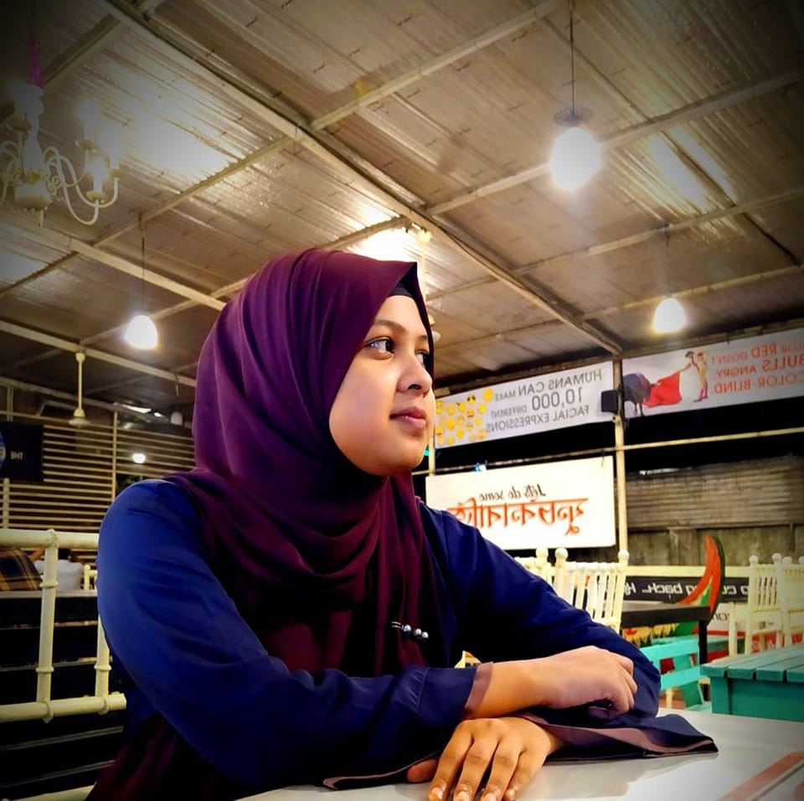

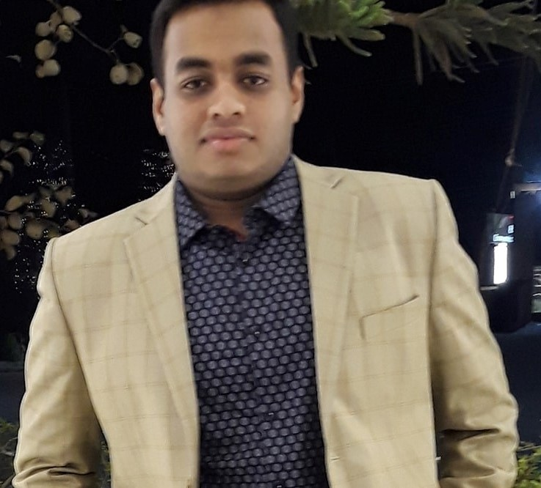
Team Introduction
Name: Rahela Begum Project Role: SEO Manager Roll: 590948 4th Semester, Computer Department
Name: Al Mohaimin Farabi Project Role: Tech Lead Roll: 590924 4th Semester, Computer Department
Name: Imran Ali Nishat Project Role: Quality Assurance Manager Roll: 590976 4th Semester, Computer Department

Slide 3


Project Introduction
The "Pet Club" platform was developed to meet the increasing demand for online shopping options for pet owners. With its user-friendly interface and comprehensive product catalog, the platform aims to provide a convenient and enjoyable shopping experience for pet lovers. Our mission is to provide authentic and good quality pet food at a cheaper price.
TECHNOLOGY USED
Pet Club Project Is Fully Based On MERN Stack. We used firebase for authentication. We have also used some React libraries to fulfill some tasks. We will talk about that in the letter.

Slide 4
Key Features
Product catalog: A comprehensive catalog of pet food and accessories, organized by category and featuring product descriptions, images, and pricing information.
Search functionality: A search feature that allows users to find specific products by name, or category.
Login system: A user login system that allows users to create their own accounts and save their personal and payment information for faster checkout in the future.
Admin-level access: A secure dashboard that allows store staff to add, edit, or delete products in the database, and to manage other aspects of the store's operations.
User-friendly interface: A design that is easy to navigate and use, with clear calls to action and intuitive controls.
Responsive design: A design that adapts to different screen sizes and devices, ensuring that the website looks and functions well on desktop computers, tablets, and smartphones.

Slide 5

Now that we've covered the background information, It's time to showcase the results of all our hard work. Let's dive into our project.

